Slide 1
Basic computation
  Variables, data types, and Java identifiers
  Assignments statements
  Simple input and screen output
  Expressions containing variables and constants
  Arithmetic operations
  Strings of characters and simple string processing
Notes:
An individual’s data is connected to enormous data from people over the world such as social network, research articles, and biomedical data on daily basis via internet.

Slide 2
Variables (변수)
  Variables는 숫자나 문자와 같은 데이터를 저장
    데이터를 저장하는 곳
    메모리에 공간이 할당됨
  변수라는 공간에는 변수값(value) 이 저장됨
  변수값은 프로그램 실행 중 변경될 수 있음

Slide 3
Variables and Values
Variables
  numberOfBaskets
  eggsPerBasket
  totalEggs
Assigning values
  eggsPerBasket = 6;
  eggsPerBasket = eggsPerBasket - 2;

Slide 4
변수 선언
  변수 이름은 용도를 인지하기 편하도록 짓는 것이 좋음
  변수 선언 시 변수 이름과 타입 (type)을 지정
    int numberOfBaskets, eggsPerBasket;
  변수 타입이 값의 종류를 결정 (int, double, char, etc.)
  변수는 반드시 다른 statements에서 사용하기 전 선언되어야 함.
  변수 선언시 값을 할당할 수 있음
    int numberOfBaskets = 1, eggsPerBasket = 12;

Slide 5
Data Types
  Class type
    데이터와 methods를 둘 다 가지는 객체에 대한 변수 형태
    예) String
  Primitive type
    한 숫자나 문자로 더 이상 잘 게 쪼개어질 수 없는 형태의 값에 대한 변수
    예) int, double, and char

Slide 6
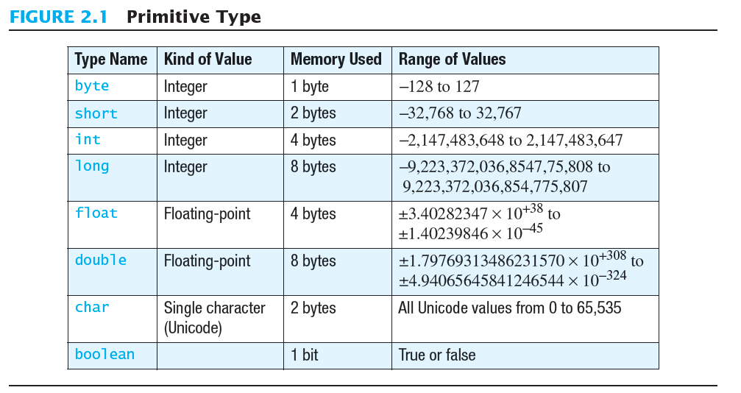
Primitive Types

Slide 7
Java Identifiers
  변수나 클래스에 대한 이름을 identifier라고 함
    문자, 숫자, and underscore character (_)
    대소문자 구별
    $는 특별한 의미
    첫자는 숫자로 시작해서는 안됨
    공백문자, 점, * (asterisk) 등은 허용 안됨
  Keywords or reserved words
    int, public, class 등은 특별한 의미를 가지고 있는 이름이어서 identifier로 사용 불가

Slide 8
Where to declare a variable
Declare a variable
  Just before it is used or
  At the beginning of the section of your program that is enclosed in {}.
  public static void main(String[] args)
  { /* declare variables here */
  . . .
  }

Slide 9
Primitive Types
Four integer types (byte, short, int, and long)
  int is most common
Two floating-point types (float and double)
  double is more common
One character type (char)
One boolean type (boolean)

Slide 10
Examples of Primitive Values
Integer types
0 -1 365 12000
Floating-point types
0.99 -22.8 3.14159 5.0
Character type
'a' 'A' '#' ' '
Boolean type
true false

Slide 11
Assignment Statements
An assignment statement is used to assign a value to a variable.
  answer = 42;
The "equal sign" is called the assignment operator.
We say, "The variable named answer is assigned a value of 42," or more simply, "answer is assigned 42."

Slide 12
Assignment Statements
Syntax
variable = expression
where expression can be another variable, a literal or constant (such as a number), or something more complicated which combines variables and literals using operators
(such as + and -)

Slide 13
Assignment Examples
amount = 3.99;
firstInitial = 'W';
score = numberOfCards + handicap;
eggsPerBasket = eggsPerBasket - 2;

Slide 14
Initializing Variables
A variable that has been declared, but no yet given a value is said to be uninitialized.
Uninitialized class variables have the value null.
Uninitialized primitive variables may have a default value.
It's good practice not to rely on a default value.

Slide 15
Initializing Variables
To protect against an uninitialized variable (and to keep the compiler happy), assign a value at the time the variable is declared.
Examples:
int count = 0;
char grade = 'A';

Slide 16
Initializing Variables
syntax
type variable_1 = expression_1, variable_2 = expression_2, …;

Slide 17
Assignment Evaluation
The expression on the right-hand side of the assignment operator (=) is evaluated first.
The result is used to set the value of the variable on the left-hand side of the assignment operator.
score = numberOfCards + handicap;
eggsPerBasket = eggsPerBasket - 2;

Slide 18
Simple Input
Sometimes the data needed for a computation are obtained from the user at run time.
Keyboard input requires
import java.util.Scanner
at the beginning of the file.

Slide 19
Simple Input
Data can be entered from the keyboard using
Scanner keyboard =
new Scanner(System.in);
followed, for example, by
eggsPerBasket = keyboard.nextInt();
which reads one int value from the keyboard and assigns it to eggsPerBasket.

Slide 20
Simple Screen Output
System.out.println("The count is " + count);
Outputs the sting literal "the count is "
Followed by the current value of the variable count.

Slide 21
Constants
Literal expressions such as 2, 3.7, or 'y' are called constants.
Integer constants can be preceded by a + or - sign, but cannot contain commas.
Floating-point constants can be written
  With digits after a decimal point or
  Using e notation.

Slide 22
e Notation
e notation is also called scientific notation or floating-point notation.
Examples
  865000000.0 can be written as 8.65e8
  0.000483 can be written as 4.83e-4
The number in front of the e does not need to contain a decimal point.

Slide 23
Imprecision in Floating-Point Numbers
Floating-point numbers often are only approximations since they are stored with a finite number of bits.
Hence 1.0/3.0 is slightly less than 1/3.
1.0/3.0 + 1.0/3.0 + 1.0/3.0
is less than 1.

Slide 24
Named Constants
Java provides mechanism to …
  Define a variable
  Initialize it
  Fix the value so it cannot be changed
public static final Type Variable = Constant;
  Example
public static final double PI = 3.14159;

Slide 25
Assignment Compatibilities
Java is said to be strongly typed.
  You can't, for example, assign a floating point value to a variable declared to store an integer.
Sometimes conversions between numbers are possible.
doubleVariable = 7;
is possible even if doubleVariable is of type double, for example.

Slide 26
Assignment Compatibilities
A value of one type can be assigned to a variable of any type further to the right
byte --> short --> int --> long
--> float --> double
  But not to a variable of any type further to the left.
You can assign a value of type char to a variable of type int.

Slide 27
Type Casting
A type cast temporarily changes the value of a variable from the declared type to some other type.
For example,
double distance;
distance = 9.0;
int points;
points = (int)distance;
Illegal without (int)

Slide 28
Type Casting
The value of (int)distance is 9,
The value of distance, both before and after the cast, is 9.0.
Any nonzero value to the right of the decimal point is truncated rather than rounded.

Slide 29
Arithmetic Operators
Arithmetic expressions can be formed using the +, -, *, and / operators together with variables or numbers referred to as operands.
  When both operands are of the same type, the result is of that type.
  When one of the operands is a floating-point type and the other is an integer, the result is a floating point type.

Slide 30
Arithmetic Operations
Example
If hoursWorked is an int to which the value 40 has been assigned, and payRate is a double to which 8.25 has been assigned
hoursWorked * payRate
is a double with a value of 500.0.

Slide 31
Arithmetic Operations
Expressions with two or more operators can be viewed as a series of steps, each involving only two operands.
  The result of one step produces one of the operands to be used in the next step.
example
  balance + (balance * rate)

Slide 32
The Division Operator
The division operator (/) behaves as expected if one of the operands is a floating-point type.
When both operands are integer types, the result is truncated, not rounded.
  Hence, 99/100 has a value of 0.

Slide 33
The mod Operator
The mod (%) operator is used with operators of integer type to obtain the remainder after integer division.
14 divided by 4 is 3 with a remainder of 2.
  Hence, 14 % 4 is equal to 2.
The mod operator has many uses, including
  determining if an integer is odd or even
  determining if one integer is evenly divisible by another integer.

Slide 34
Parentheses and Precedence
Parentheses can communicate the order in which arithmetic operations are performed
examples:
(cost + tax) * discount
(cost + (tax * discount)
Without parentheses, an expressions is evaluated according to the rules of precedence.

Slide 35
Precedence Rules
The binary arithmetic operators *, /, and %, have lower precedence than the unary operators +, -, ++, --, and !, but have higher precedence than the binary arithmetic operators + and -.
When binary operators have equal precedence, the operator on the left acts before the operator(s) on the right.

Slide 36
Specialized Assignment Operators
Assignment operators can be combined with arithmetic operators (including -, *, /, and %, discussed later).
amount = amount + 5;
can be written as
amount += 5;
yielding the same results.

Slide 37
Increment and Decrement Operators
Used to increase (or decrease) the value of a variable by 1
Easy to use, important to recognize
The increment operator
  count++ or ++count
  count = count + 1;
The decrement operator
  count-- or –count
  count = count - 1;

Slide 38
Increment and Decrement Operators in Expressions
after executing
  int m = 4;
  int result = 3 * (++m)
  result has a value of 15 and m has a value of 5
after executing
  int m = 4;
  int result = 3 * (m++)
  result has a value of 12 and m has a value of 5

Slide 39
The Class String
We've used constants of type String already.
  "Enter a whole number from 1 to 99."
A value of type String is a
  Sequence of characters
  Treated as a single item.

Slide 40
String Constants and Variables
Declaring
String greeting;
  greeting = "Hello!";
  or
  String greeting = "Hello!";
  or
  String greeting = new String("Hello!");
Printing
System.out.println(greeting);

Slide 41
Concatenation of Strings
Two strings are concatenated using the + operator.
  String greeting = "Hello";
  String sentence;
  sentence = greeting + " officer";
  System.out.println(sentence);
Any number of strings can be concatenated using the + operator.

Slide 42
Concatenation of Strings and Integers
String solution;
solution = "The answer is " + 42;
System.out.println (solution);
The temperature is 72
The answer is 42

Slide 43
String Methods
An object of the String class stores data consisting of a sequence of characters.
Objects have methods as well as data
The length() method returns the number of characters in a particular String object.
  String greeting = "Hello";
  int n = greeting.length();

Slide 44
The Method length()
The method length() returns an int.
You can use a call to method length() anywhere an int can be used.
  int count = command.length();
  System.out.println("Length is " +
  command.length());
  count = command.length() + 3;

Slide 45
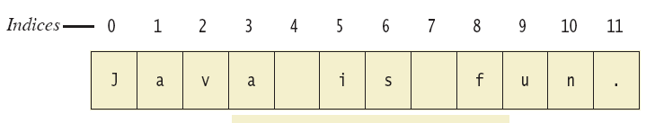
String Indices
Positions start with 0, not 1.
  The 'J' in "Java is fun." is in position 0
A position is referred to an an index.
  The 'f' in "Java is fun." is at index 8.

Slide 48
Escape Characters
How would you print
  "Java" refers to a language. ?
The compiler needs to be told that the quotation marks (") do not signal the start or end of a string, but instead are to be printed.
  System.out.println(
  "\"Java\" refers to a language.");

Slide 49
Escape Characters
Figure 2.6
Each escape sequence is a single character even though it is written with two symbols.

Slide 50
Examples
System.out.println("abc\\def");
System.out.println("new\nline");
char singleQuote = '\'';
System.out.println
(singleQuote);
abc\def
new
line
'

Slide 51
Screen Output
We've seen several examples of screen output already.
System.out is an object that is part of Java.
println() is one of the methods available to the System.out object.

Slide 52
Screen Output
The concatenation operator (+) is useful when everything does not fit on one line.
  System.out.println("Lucky number = " + 13 +
  "Secret number = " + number);
Do not break the line except immediately before or after the concatenation operator (+).

Slide 53
Screen Output
Alternatively, use print()
  System.out.print("One, two,");
  System.out.print(" buckle my shoe.");
  System.out.println(" Three, four,");
  System.out.println(" shut the door.");
  ending with a println().

Slide 54
Keyboard Input
Java has reasonable facilities for handling keyboard input.
These facilities are provided by the Scanner class in the java.util package.
  A package is a library of classes.

Slide 55
Using the Scanner Class
Near the beginning of your program, insert
  import java.util.Scanner;
Create an object of the Scanner class
  Scanner keyboard =
  new Scanner (System.in)
Read data (an int or a double, for example)
  int n1 = keyboard.nextInt();
  double d1 = keyboard,nextDouble();

Slide 56
nextLine()Method Caution
The nextLine() method reads
  The remainder of the current line,
  Even if it is empty.

Slide 57
nextLine()Method Caution
Example – given following declaration.
  int n;
  String s1, s2;
  n = keyboard.nextInt();
  s1 = keyboard.nextLine();
  s2 = keyboard.nextLine();
Assume input shown
  n is set to 42
  but s1 is set to the empty string.
  42
  and don't you
  forget it.

Slide 58
The Empty String
A string can have any number of characters, including zero.
The string with zero characters is called the empty string.
The empty string is useful and can be created in many ways including
  String s3 = "";

Slide 59
Comments
The best programs are self-documenting.
  Clean style
  Well-chosen names
Comments are written into a program as needed explain the program.
  They are useful to the programmer, but they are ignored by the compiler.

Slide 60
Comments
A comment can begin with //.
Everything after these symbols and to the end of the line is treated as a comment and is ignored by the compiler.
  double radius; //in centimeters

Slide 61
Comments
A comment can begin with /* and end with */
Everything between these symbols is treated as a comment and is ignored by the compiler.
  /**
  This program should only
  be used on alternate Thursdays,
  except during leap years, when it should
  only be used on alternate Tuesdays.
  */

